Slide 1





⥫
Simple Autoencoder
on the MNIST Dataset
PRESENTED BY: ASWIN DHURAI C
REG_NO: 962821104017
DEPT: Computer Science and Engineering
NM_ID: au962821101017
EMAIL_ID: aswindhurai01@gmail.com

Slide 2





Introduction
An autoencoder is a type of artificial neural network used to learn efficient coding of input data in an unsupervised manner
The objective of an autoencoder is to encode the input data into a lower-dimensional representation and then reconstruct the output to be as close to the original input as possible.

Slide 3






The goal of this program is to implement an autoencoder using TensorFlow and Keras to perform unsupervised learning on the MNIST dataset.
Problem Statement
The autoencoder should effectively compress the input data (handwritten digit images) into a lower-dimensional representation and then reconstruct the data to be as close to the original images as possible.

Slide 4
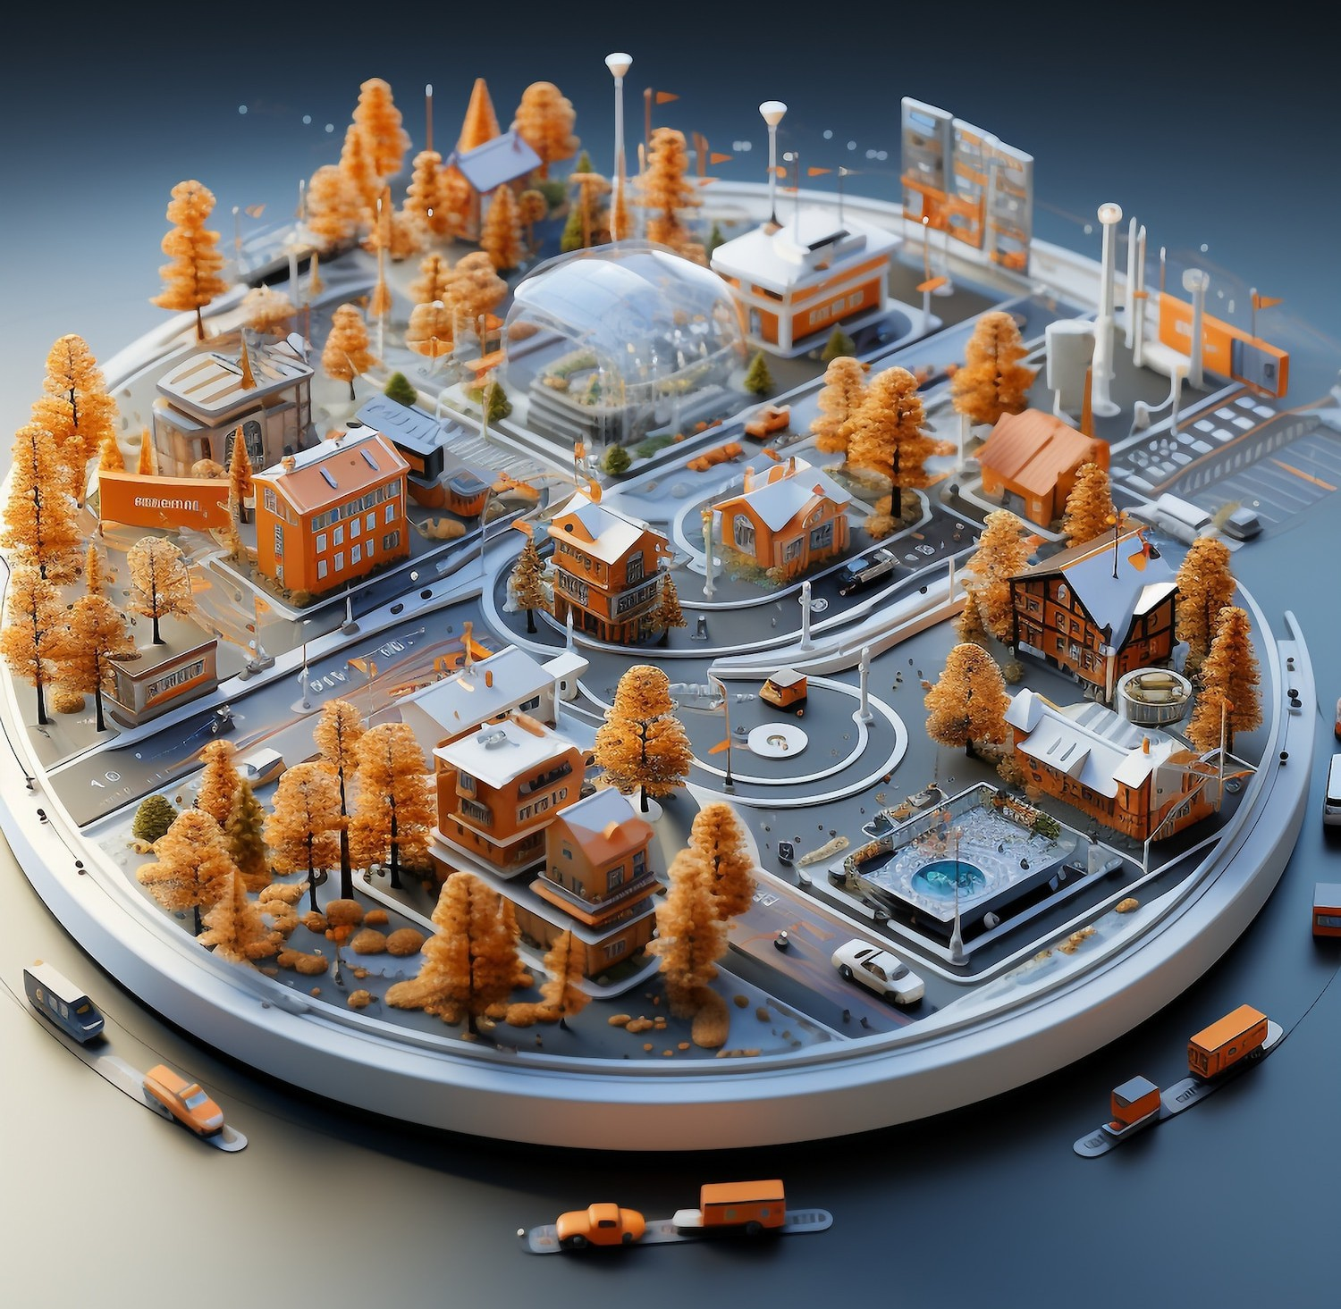
Problem Overview: Data Limitations: Traditional digit recognition methods rely on labeled datasets, which are often limited in size and diversity. This can restrict model performance and generalizability. Robustness and Generalization: Existing digit recognition models may struggle to generalize well to unseen data or handle variations in input, such as different handwriting styles or orientations.

Slide 5
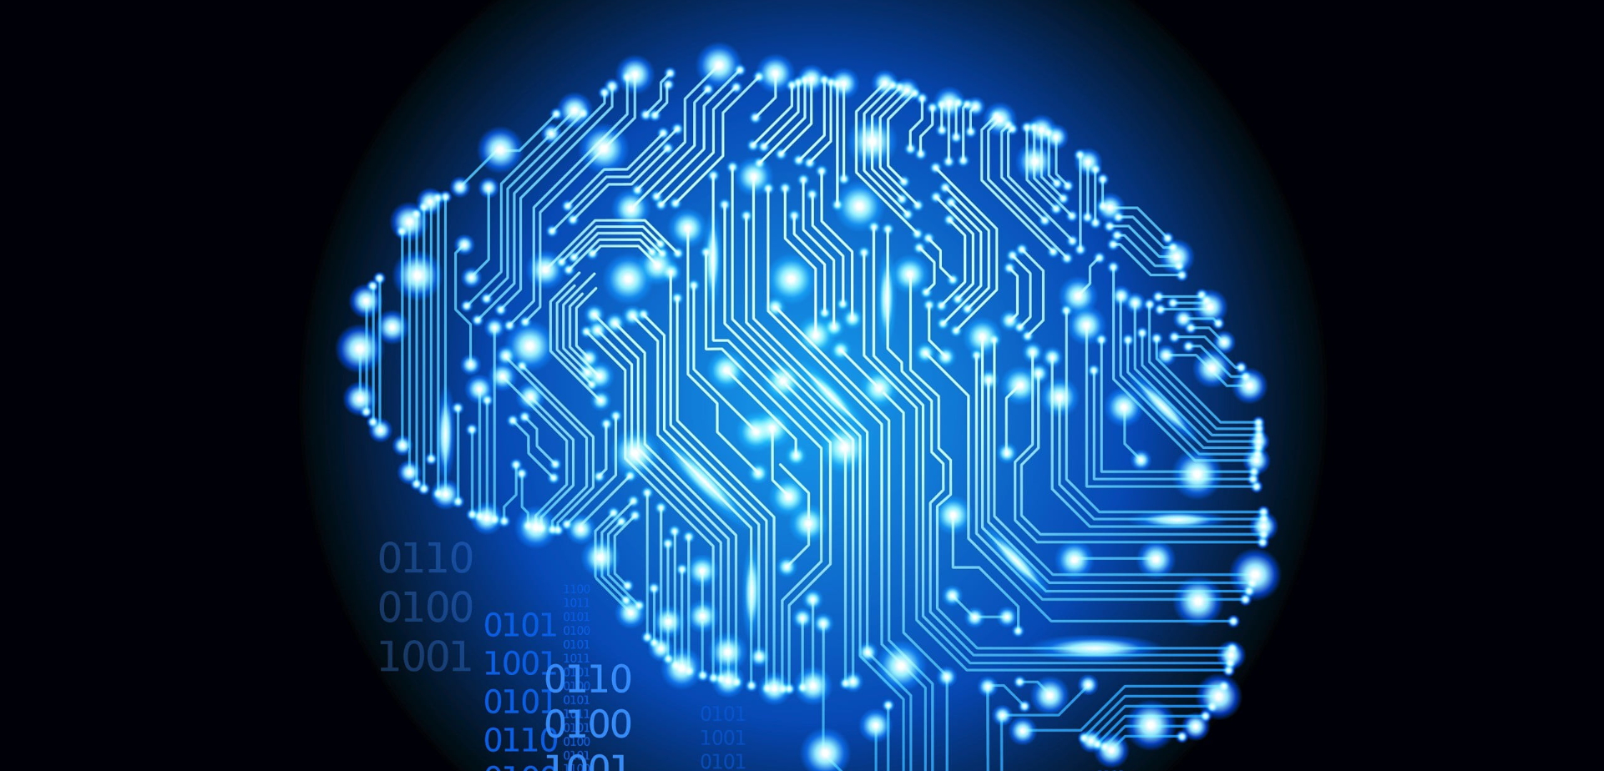




Problem Modelling: Problem Definition: Define the objective of digit reconstruction using autoencoders, such as reducing the dimensionality of handwritten digit images while maintaining the ability to accurately reconstruct the original images. Data Collection and Preprocessing: Gather a dataset of real digit images, such as the MNIST dataset, which contains labeled handwritten digit images. Preprocess the data by normalizing pixel values to be between 0 and 1 and flattening the images into vectors suitable for training the autoencoder. Training the AutoEncoder: Train the autoencoder on the real digit images dataset. The encoder learns to compress the input images into a lower-dimensional representation, while the decoder learns to reconstruct the original images from this compressed representation. This involves optimizing the model to minimize reconstruction error through the training process.

Slide 6
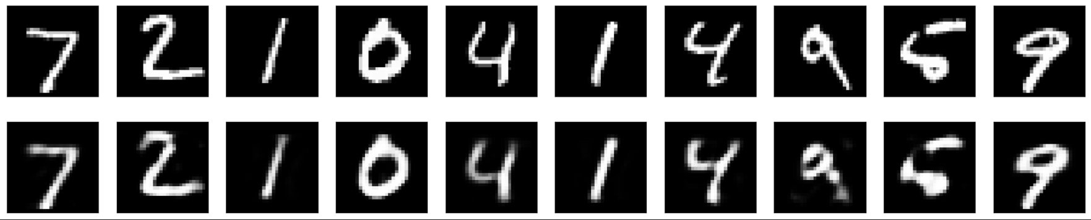
RESULT:

Slide 7
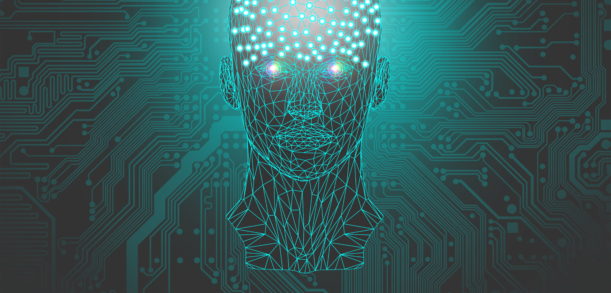



Conclusion:
In conclusion, digit recognition using autoencoders presents a promising approach to address some of the limitations faced by traditional methods. By learning efficient, lower-dimensional representations of digit images, autoencoders enable effective data compression and reconstruction. This technique helps to improve model performance and robustness, offering a means to better handle and interpret high-dimensional data while preserving essential features.

Slide 8











ThanKs!

